Slide 1
TOPOLOGICAL DATA ANALYSIS
MINH QUANG LE

Slide 2
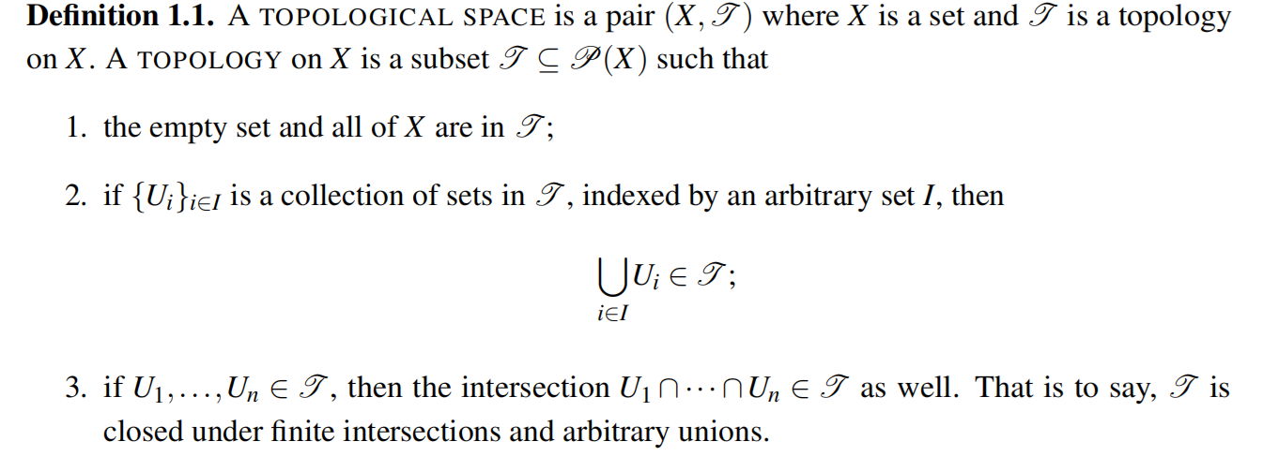
INTRODUCTION TOPOLOGY

Slide 3
INTRODUCTION TOPOLOGY

Slide 4
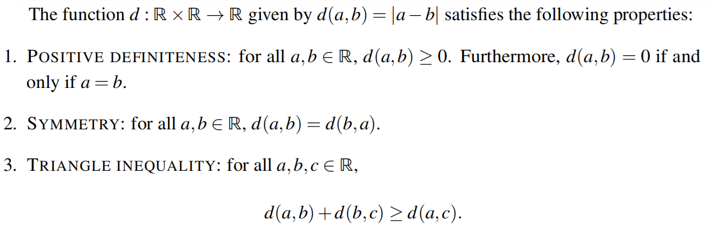
INTRODUCTION TOPOLOGY

Slide 5
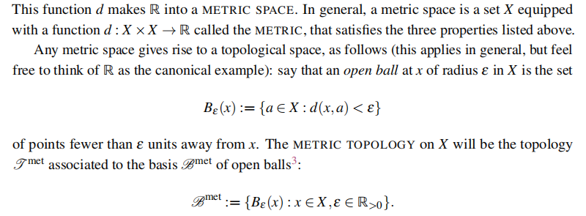
INTRODUCTION TOPOLOGY

Slide 6
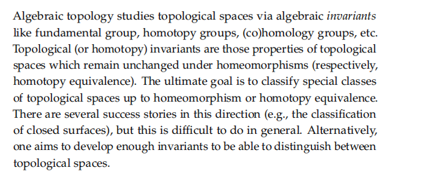
ALGEBRAIC TOPOLOGY

Slide 7
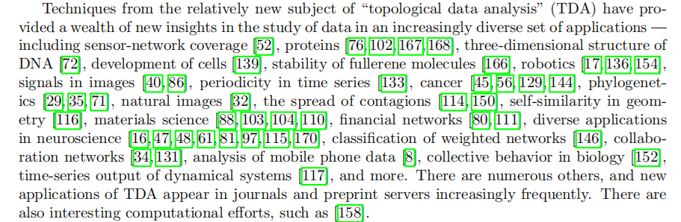
TOPOLOGICAL DATA ANALYSIS (TDA)

Slide 8
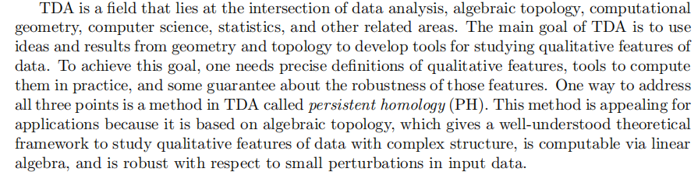
TDA

Slide 9
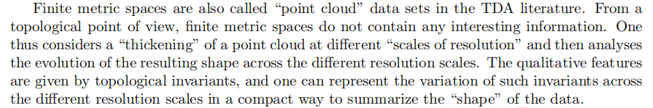
TDA

Slide 10
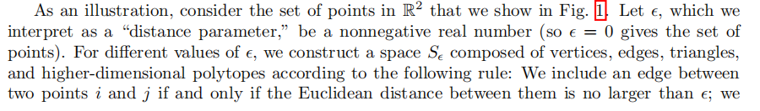
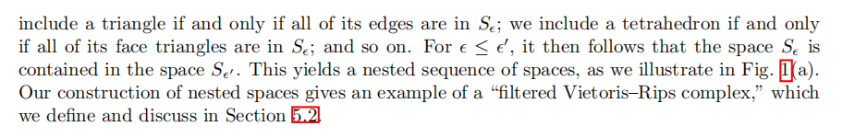
TDA

Slide 11
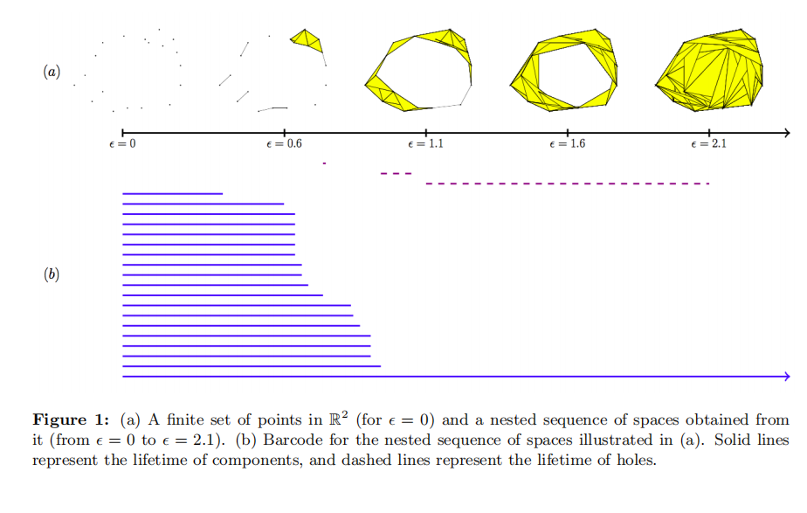
TDA

Slide 12
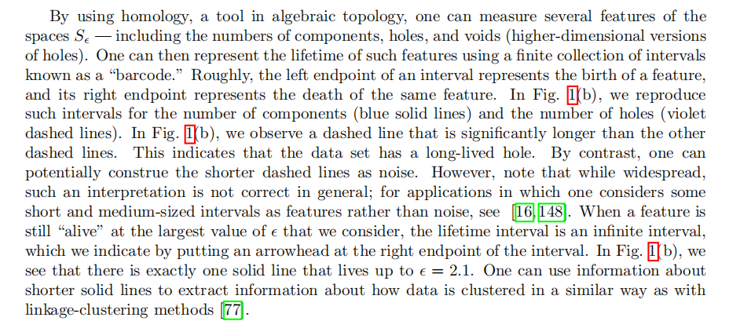
TDA

Slide 13
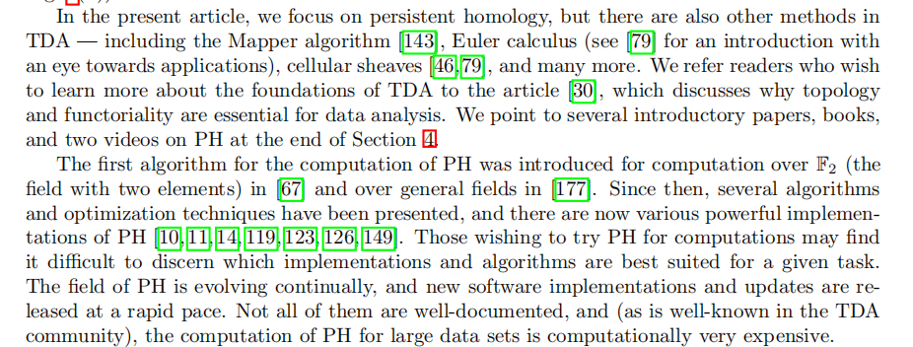
TDA

Slide 14
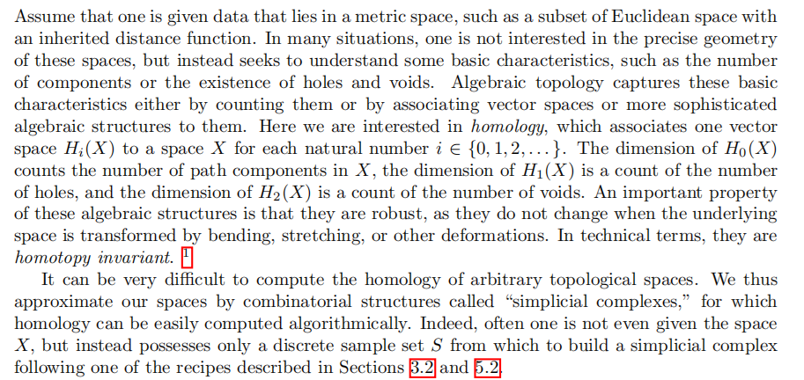
HOMOLOGY

Slide 15
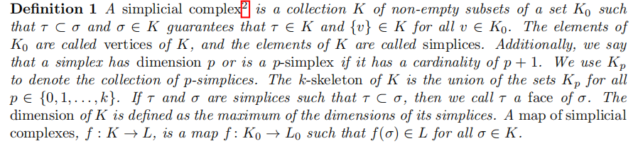
HOMOLOGY

Slide 16
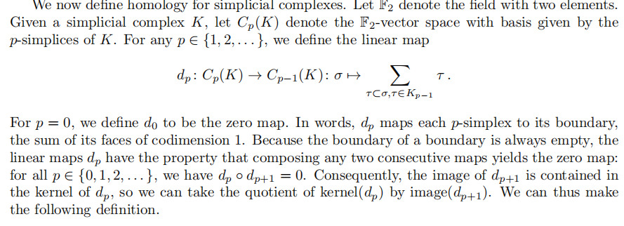
HOMOLOGY

Slide 17
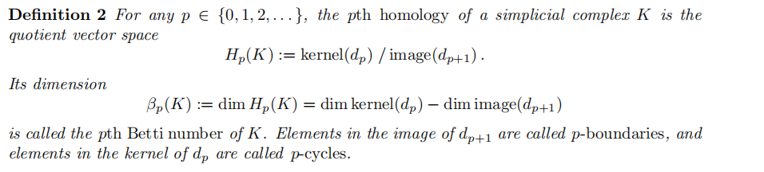
HOMOLOGY

Slide 18
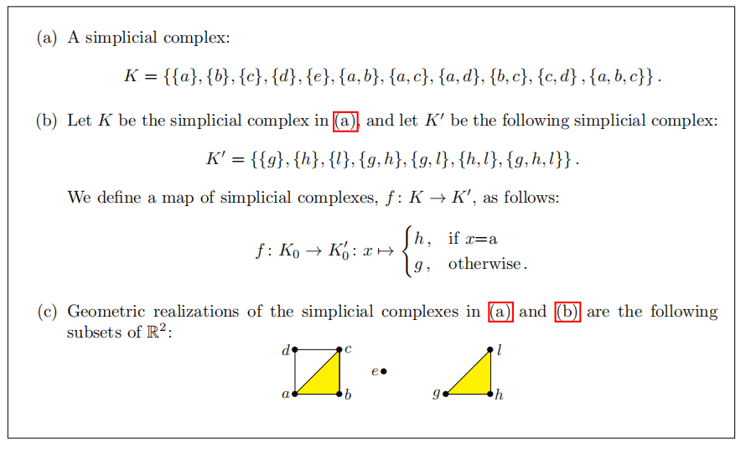
HOMOLOGY

Slide 19
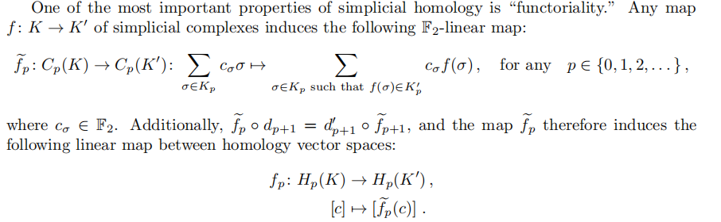
PERSISTENT HOMOLGY (PH)

Slide 20
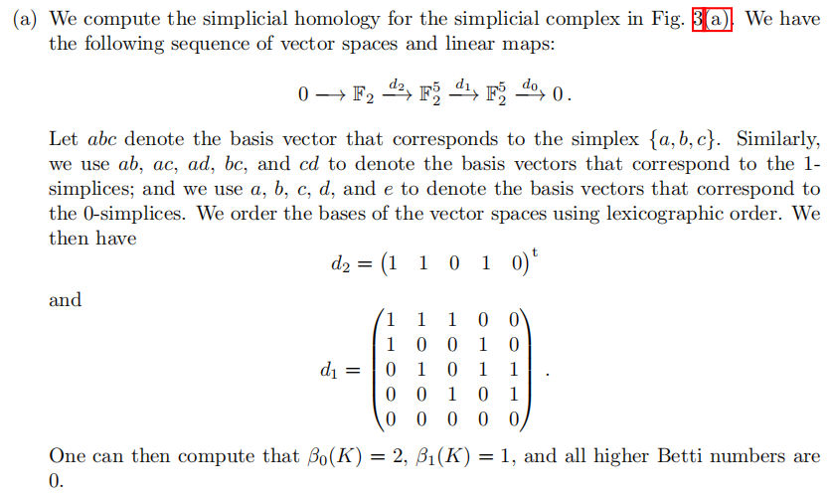
PH

Slide 21
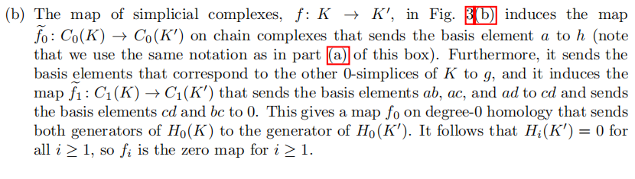
PH

Slide 22
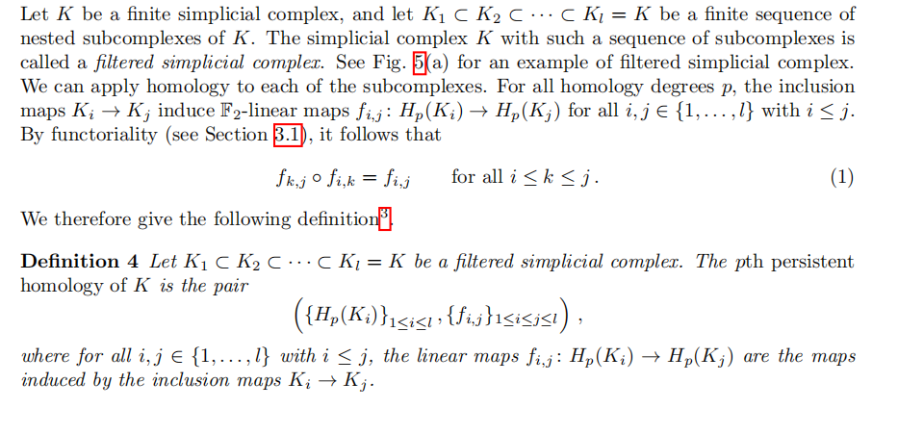
PH

